Slide 1
Reminders from Dr. Dawson:
Monday will be Active Learning 3 with Professor Yeargain; quiz will be open all day Monday. Answer key will be posted on Tuesday.
Wednesday is Exam 3! Covers Ch 8-10, 32 multiple choice questions. Exam/Scantron provided. Bring UCF ID and pencil.
Ch 8-10 quizzes due Wed. by 11:59pm.
No Class- Friday March 6. Enjoy ☺
I’ll be back to start Block 3 content on Monday March 9

Slide 2
Photosynthesis
Chapter 10

Slide 3
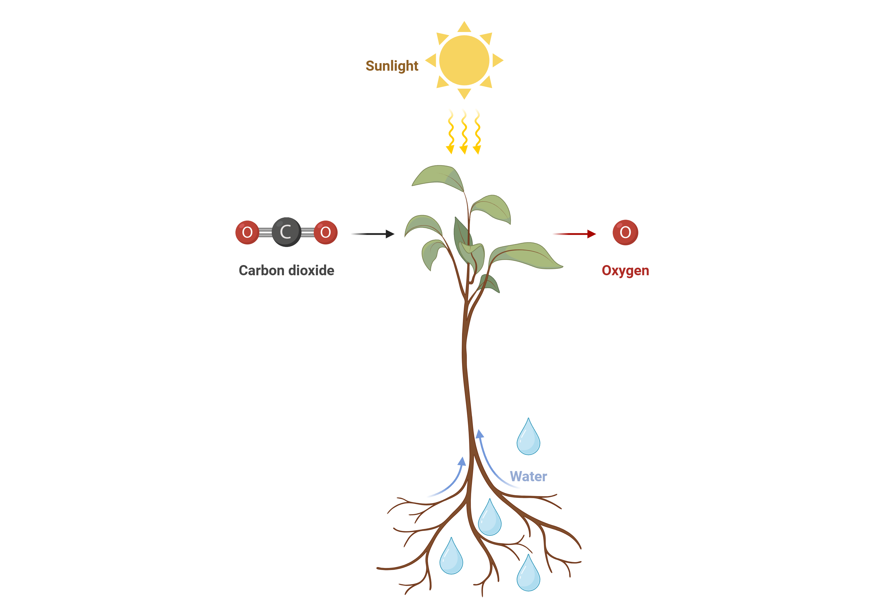

Slide 4
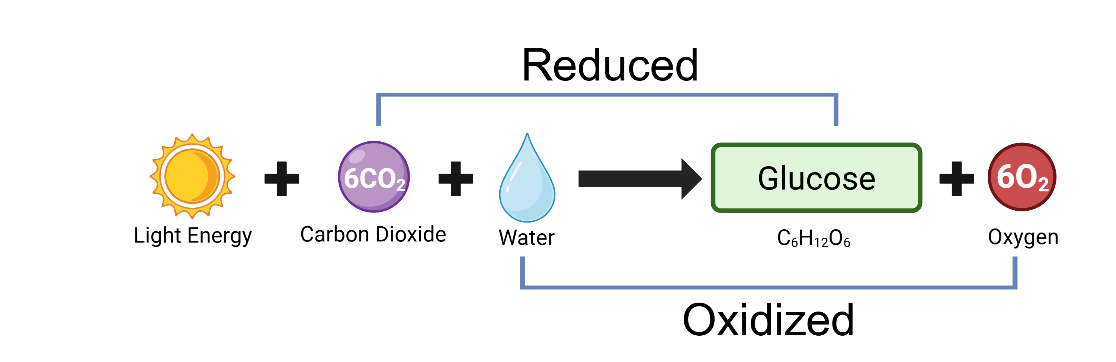
Photosynthesis Equation

Slide 5
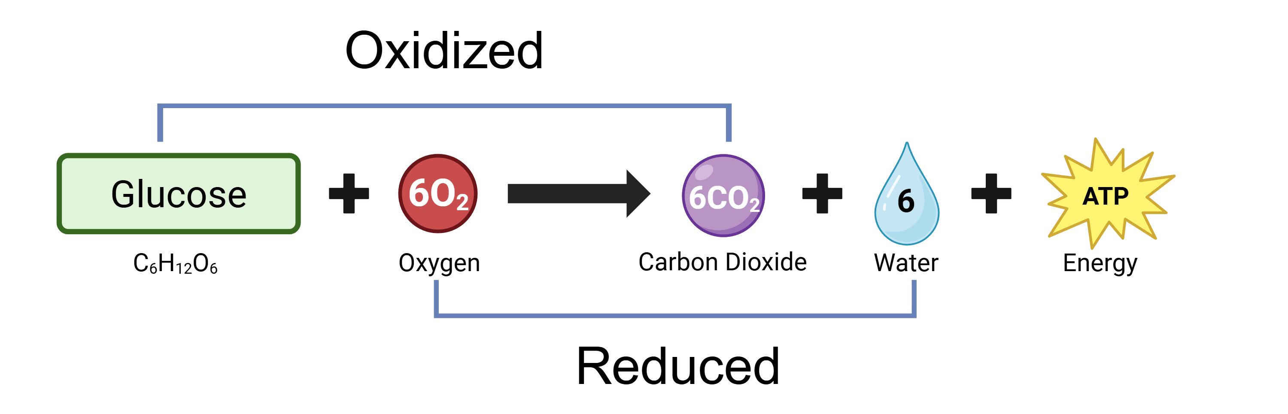
Photosynthesis Equation
Cellular Respiration Equation

Slide 6
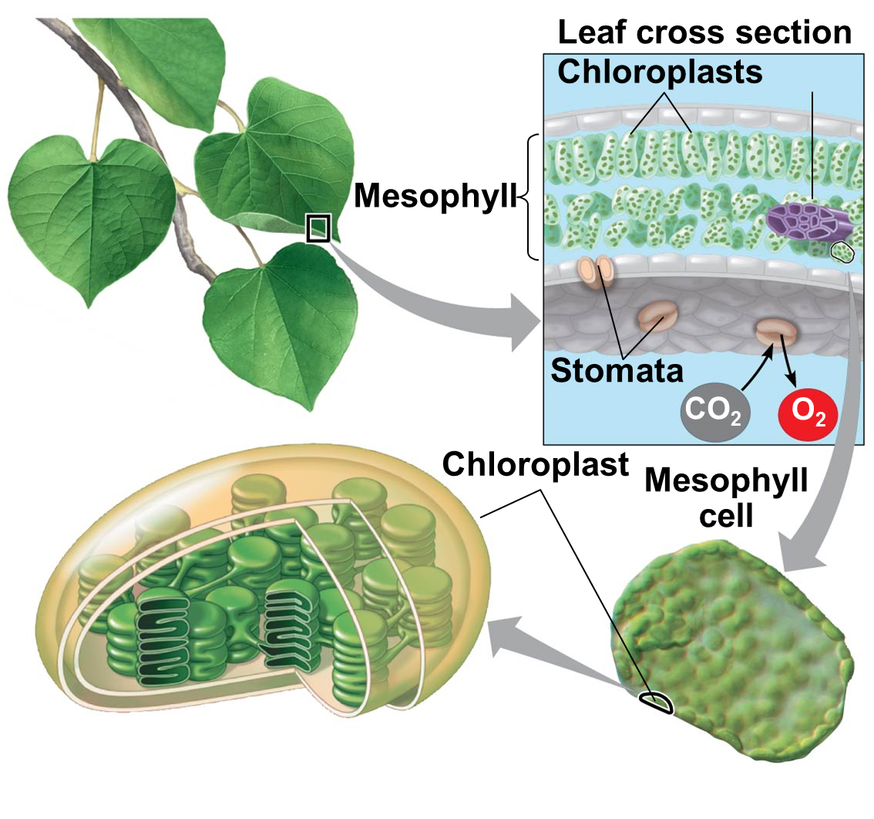

Slide 7
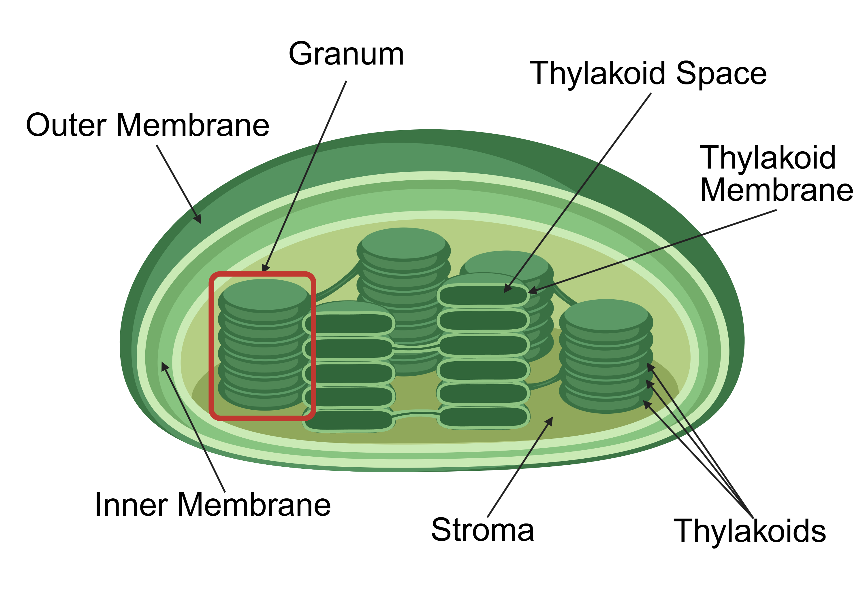
Chloroplast Structure

Slide 8
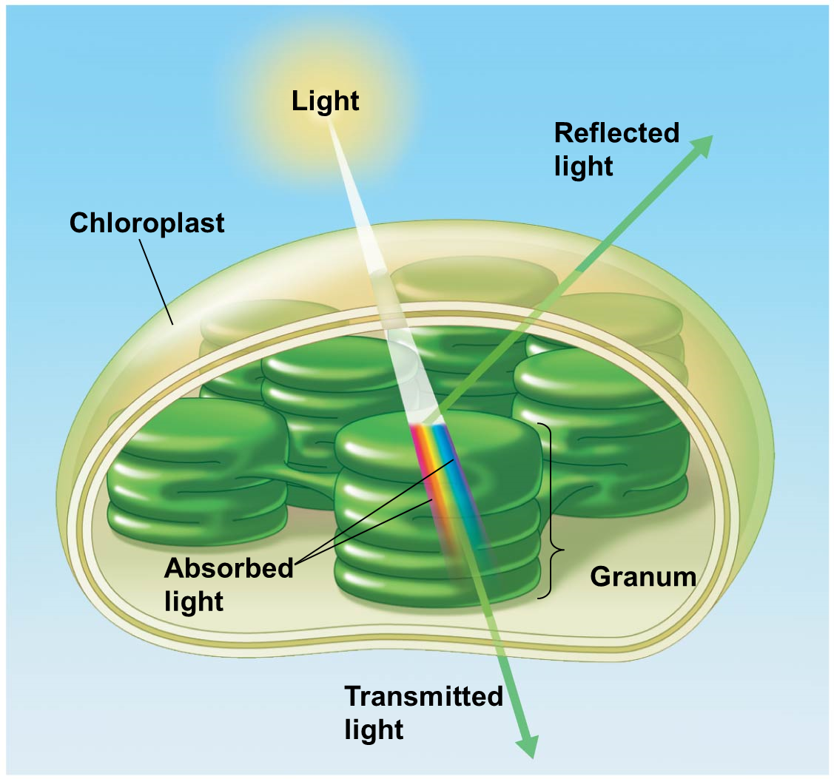
ABSORBED
REFLECTED
ABSORBED

Slide 9
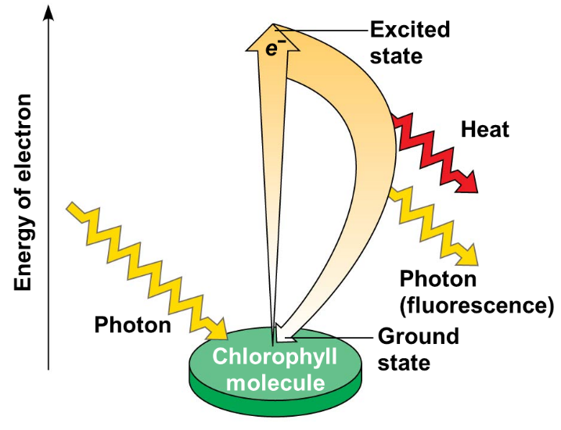
Chlorophyll excitation
When a molecule of chlorophyll absorbs a photon of light, it goes from a stable state to an excited state.
  Individual electrons in the chlorophyll absorb the light energy causing the electron to move to a higher orbital (new outer shell)
  As electron falls back to its original orbital, it gives off energy

Slide 10
Two stages of Photosynthesis
Light reaction (the photo part)
  Converts light energy to chemical energy
  Occurs during the day
Calvin cycle (the synthesis part)
  Uses products from light reaction to produce G3P sugar
  Occurs during day or night

Slide 11
Light Reaction (the photo part)
When: First phase
Where: Thylakoid membrane
Who is the main player: Sunlight
What goes in:
  Light energy
  H₂O
  ADP
  NADP⁺
What comes out:
  ATP (goes to Calvin Cycle)
  NADPH (goes to Calvin Cycle)
  O₂ (released from plant into environment)
Why is this happening: Converts light energy to chemical energy (ATP) and electron carrier NADPH

Slide 12
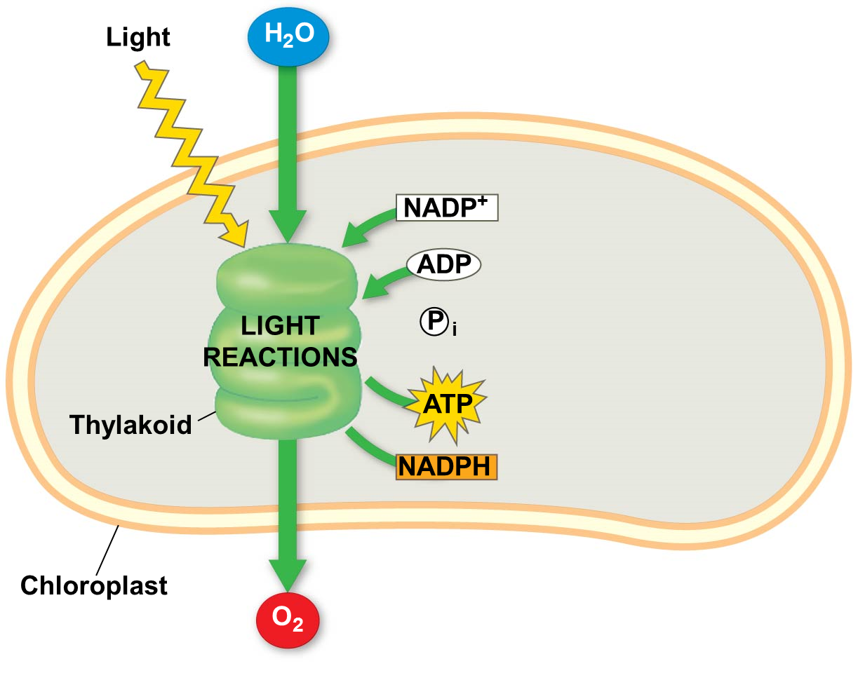

Slide 13
Chlorophyll Photosystems
Chlorophyll molecules in plant cells are surrounded by other chlorophyll molecules
  Each molecule absorbs light energy from the sun
    Electrons jump up/fall back, give off energy
    Energy given off is transmitted to another chlorophyll molecule
      Causes an electron in that molecule to jump up/fall back
In plants, we call these light harvesting complexes Photosystems
  Located in the thylakoid membrane

Slide 14
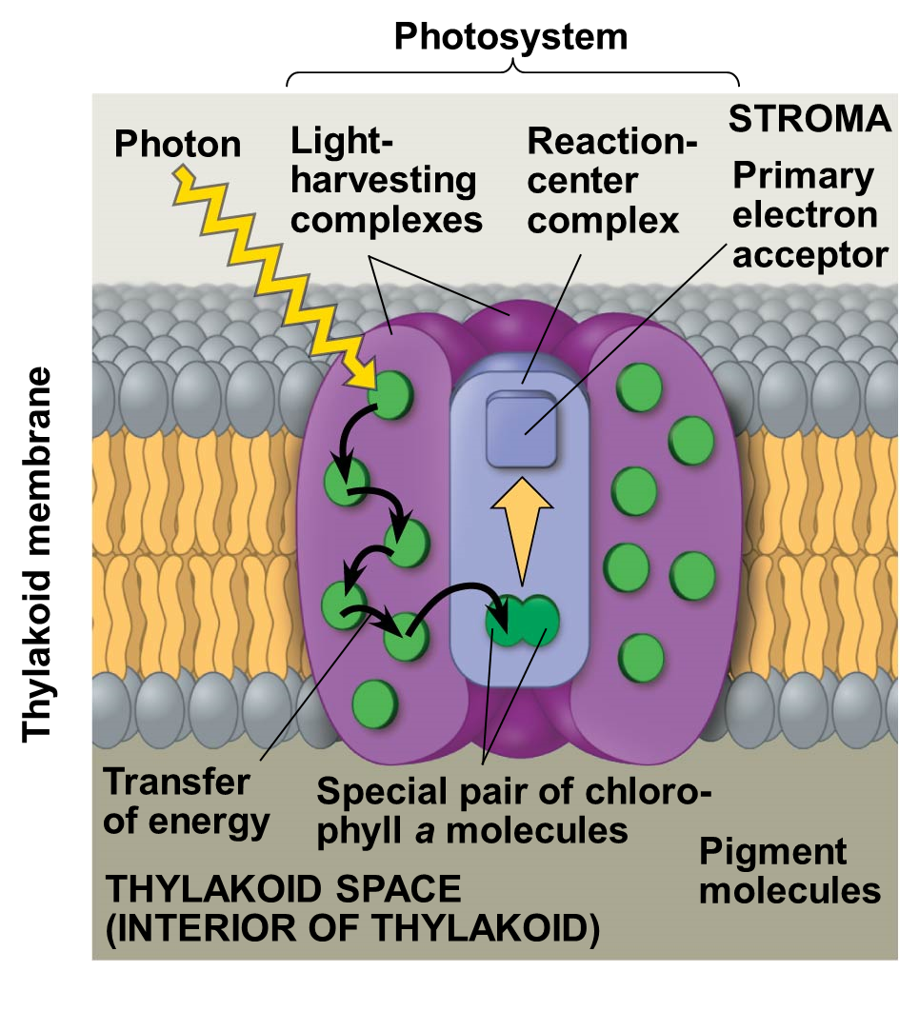
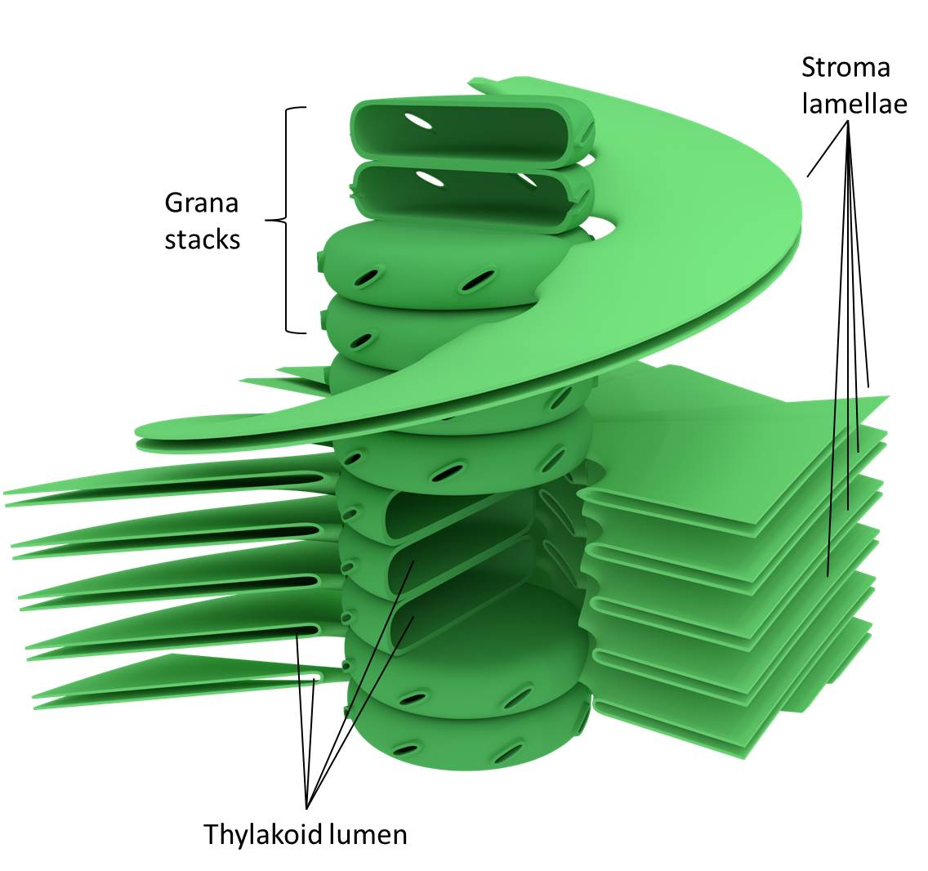

Slide 15
Two Photosystems
Photosystem II
  Chlorophyll a (P680)
Photosystem I
  Chlorophyll a (P700)
Photosystem II is upstream of Photosystem I
Photosystem II charges Photosystem I via electron transport chain
Photosystem I reduces NADP+ to NADPH
This is linear electron flow

Slide 16
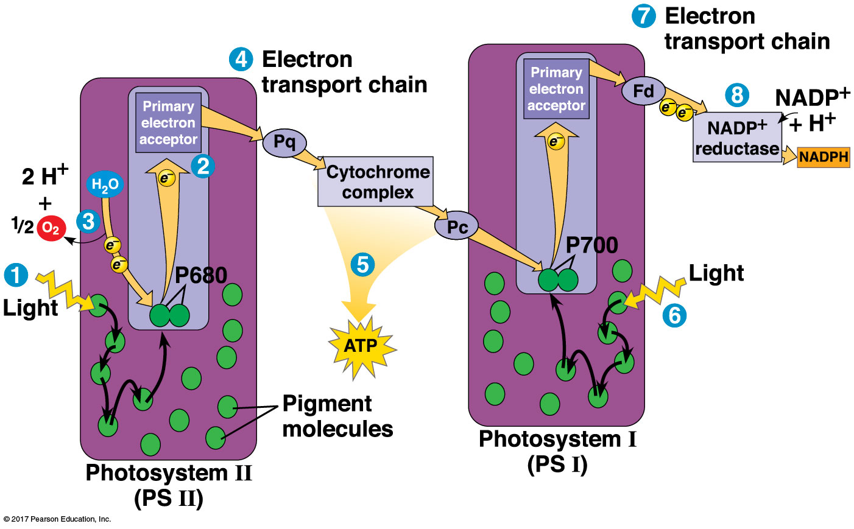
Linear Electron Flow

Slide 17
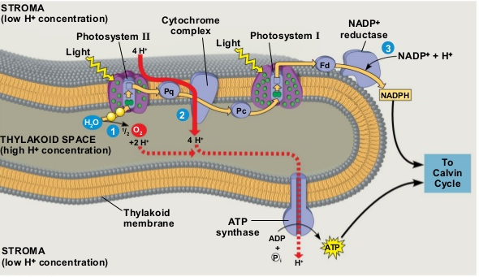
Putting it all together:

Slide 18
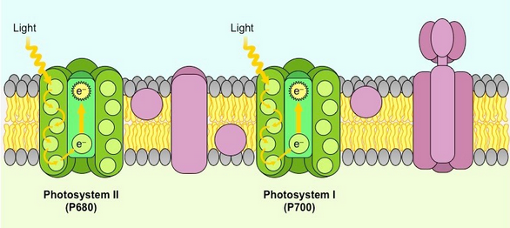
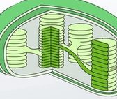
Use this diagram to trace the flow of electrons in this linear electron flow.

Slide 19
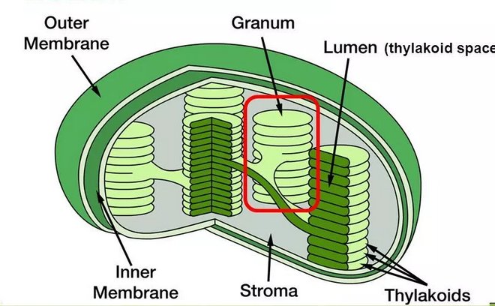
Calvin Cycle
Uses ATP and NADPH from Light Reaction to reduce CO₂ to G3P
  Anabolic (building big molecule)
Occurs in the stroma of chloroplast
Occurs during the day or night

Slide 20
Calvin Cycle
Three sub-phases:
  (carbon) Fixation phase
    “Fixes” carbon, turns inorganic C02 into organic mol’c.
    Catalyzed by rubisco
  Reduction phase
    Reduce # of Phosphate groups
  Regeneration (of CO₂ acceptor) phase
    Regenerate RuBP to start cycle again

Slide 21
Calvin Cycle (the synthesis part)
When: After Light Reaction
Where: In Stroma
Who is the main player: CO₂
What goes in:
  9 ATP (from light reactions)
  6 NADPH (from light reactions)
  3 CO₂ (Plant absorbs from atmosphere)
What comes out:
  9 ADP
  6 NADP⁺
  6 G3P (a 3 carbon sugar)
    One goes toward building sugar, starch, cellulose
    The other 5 recycle back to RuBP in the regeneration phase
Why is this happening: Make G3P

Slide 22
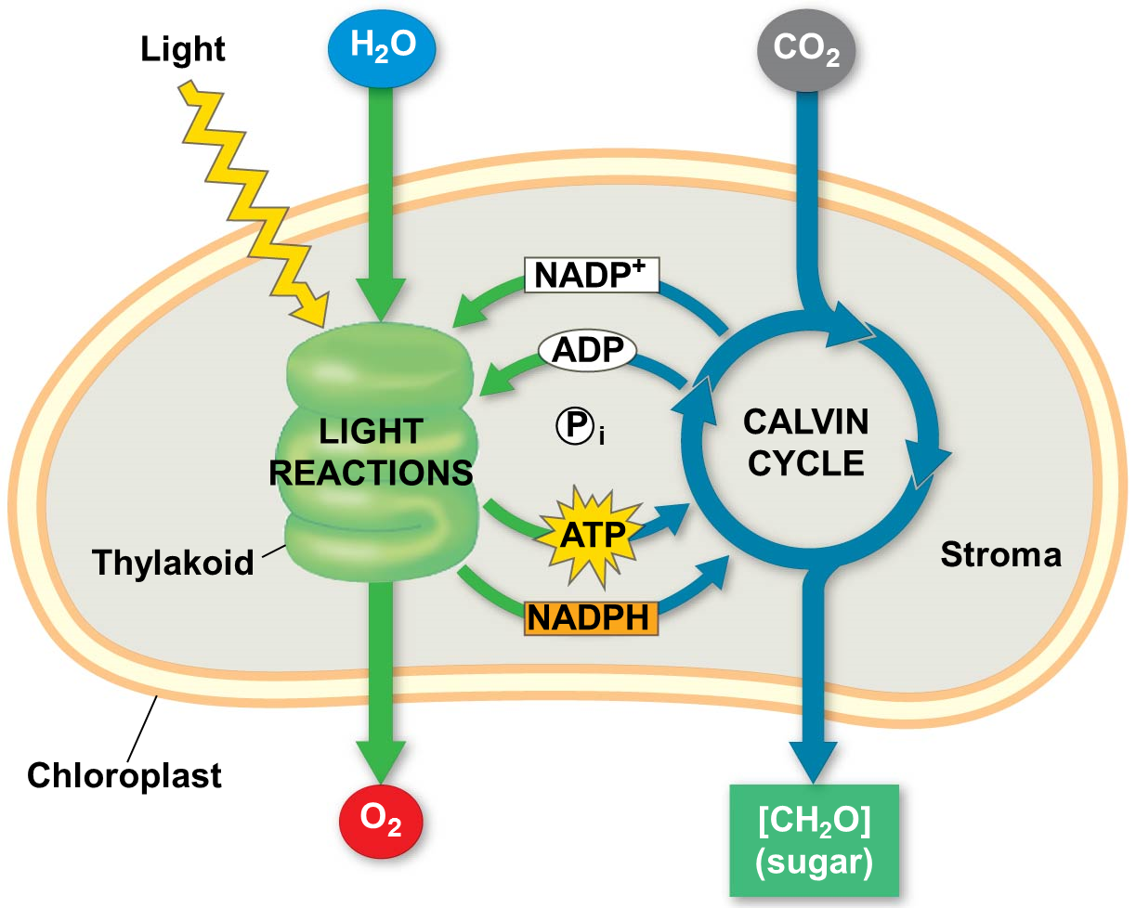
G3P

Slide 23
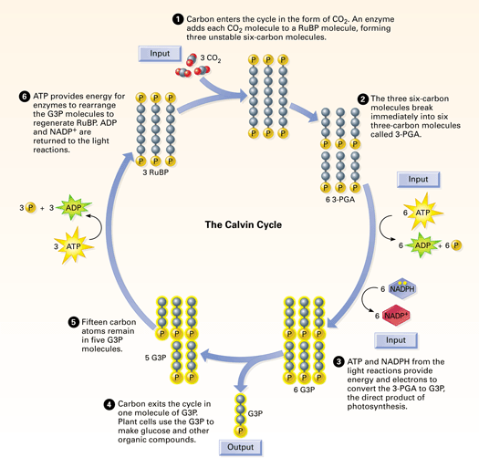
Uses Rubisco Enzyme
Unstable 6 carbon →
5 carbon molecule
Carbon Fixation Phase

Slide 24
3 carbon
Reduction Phase
Need energy to convert between molecules
3 carbon
1 G3P go to the cell’s energy, 5 remain in the cycle

Slide 25
ATP used to regenerate RuBP
Use 3 more ATP
Regeneration
Phase
5 G3P remain in the cycle

Slide 26
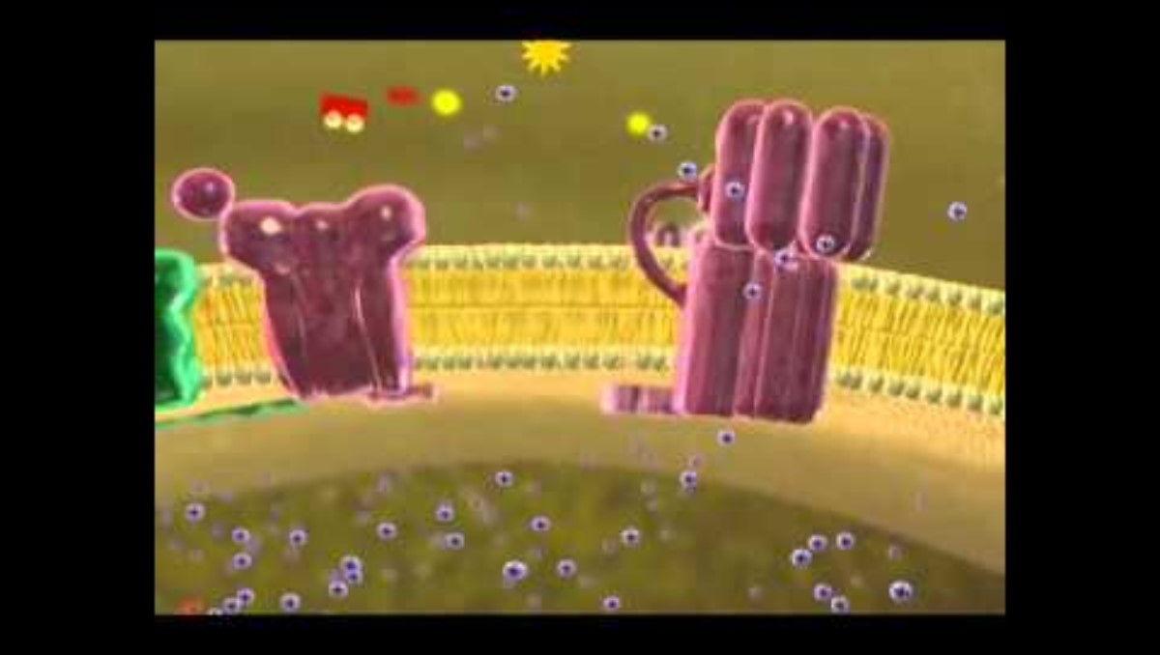
Photosynthesis video

Slide 27
Photosynthesis Summary
Light Reaction
Calvin Cycle
Occurs in Thylakoid
Occurs during day
What goes in:
  Light energy
  Water
  ADP
  NADP+
What comes out:
  ATP
  NADPH
  O₂
Occurs in Stroma
Occurs day or night
What goes in:
  ATP
  NADPH
  CO₂
What comes out:
  NADP+
  ADP
  G3P (sugar)

